Slide 1

TeCH ON FIRe

Slide 2

Design Patterns with LLMs

Slide 3
What is
An LLM ?
LLM =
Large
Language
Model

Slide 4
What is
An LLM ?
“Why do apples...”
“…fall from trees”
“…turn brown when cut?”
“…float in water?”

Slide 5
What is
An LLM ?
“I have a bug. Can you help?”
Are you sick?
Do you need an exterminator?
You heard something?
Is your code broken?

Slide 6
Using
LLMs
Text Generation
Translation
Answering Questions
Summarizing Text
Text Completion
Code Generation
Content Moderation
Searching
Sentiment Analysis
Brainstorming
Grammar Checking

Slide 7
What is
An LLM ?
Parameters – the number of “knobs” available on the LLM.
Tokens/Prompt – what you provide to the LLM as part of your query.
Batch Size – the size of the test data used for generating an LLM.
Training
Data
Training
Candidate
Model
Validation
Output
Model
Dataset
Testing
Data

Slide 8
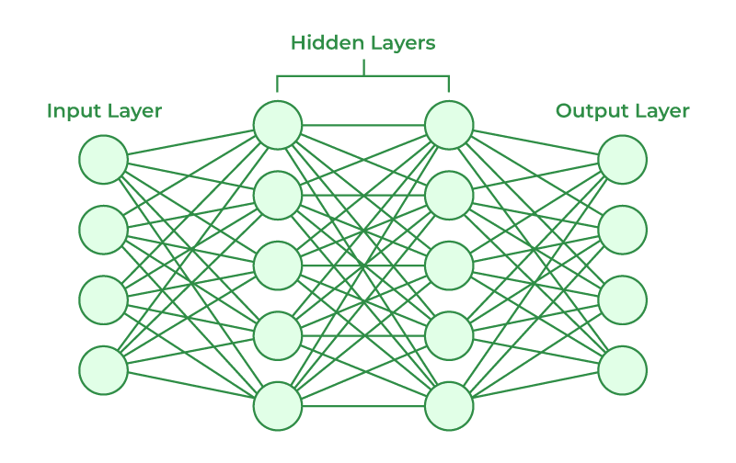
What is
An LLM ?

Slide 9
What is
An LLM ?

Slide 10
PrOmpt engineering
Zero-Shot Prompting: Providing a task without prior examples, relying on the model's pre-existing knowledge.
One-Shot Prompting: Giving the model one example before the actual task to guide its response.
Few-Shot Prompting: Supplying a few examples before the actual task to help the model understand the desired output.
Chain-of-Thought Prompting: Breaking down complex tasks into intermediate steps to guide the model to a solution.
Self-Improving Prompt: Allowing the model to reflect on and iteratively refine its own responses.
Instruction-Based Prompting: Using clear and direct instructions to specify the task, format, tone, or content.
Analogical Reasoning Prompt: Leveraging analogies to help the model draw parallels and approach new tasks.
Hybrid Prompting: Combining elements from various prompting techniques for complex or nuanced tasks.

Slide 11
PrOmpt engineering
Zero-Shot Prompting: Providing a task without prior examples, relying on the model's pre-existing knowledge.
“Write a poem about a robot who dreams of becoming a gardener.”
“Explain quantum entanglement in simple terms.”
“Compose a persuasive essay arguing for the ethical implications of artificial intelligence.”

Slide 12
Direct InvOcatiOn
(Zero-Shot,
Multishot)
API
Client
App
Context
LLM Model
(Pretrained)
Client
App
Context
Client
App
Context

Slide 13
Direct InvOcatiOn
(Zero-Shot,
Multishot)
Python API
Client
App
Context
GPT 3.5
Client
App
Context
HTML Client

Slide 14
PrOmpt engineering
N-Shot Prompting: Giving the model one example before the actual task to guide its response.
“Example: "The quick brown fox jumps over the lazy dog." Task: Write a sentence using all 26 letters of the alphabet.”
“Example: "The cat sat on the mat." Task: Write a sentence using the same word order but replacing the words with synonyms.”
“Example: "The apple is red." Task: Write a sentence describing a blue object.”

Slide 15
PrOmpt engineering
Self-Improving Prompt: Allowing the model to reflect on and iteratively refine its own responses.
“Write a short story about a robot who falls in love with a human. Feedback: The story was engaging, but the ending felt rushed. Try to add more detail to the conclusion.”
“Write a poem about the beauty of nature. Feedback: The poem was well-written, but it could be more specific in its imagery. Try to use more vivid descriptions of the natural world.”
“Write a persuasive essay arguing for the importance of education. Feedback: The essay was informative, but it could be more persuasive. Try to use stronger examples and evidence to support your argument.”

Slide 16
PrOmpt engineering
Instruction-Based Prompting: Using clear and direct instructions to specify the task, format, tone, or content.
“Write a 500-word essay in a formal tone about the history of artificial intelligence.”
“Write a humorous poem about a cat who thinks it's a superhero.”
“Write a persuasive letter to your local representative arguing for stricter gun control laws.”

Slide 17
PrOmpt engineering
Analogical Reasoning Prompt: Leveraging analogies to help the model draw parallels and approach new tasks.
Prompt: If a book is to a reader as a meal is to a diner, then what is a teacher to a student?
Prompt: Just as a painter uses a brush to create a masterpiece, a writer uses words to create a story.
Prompt: If a car is to a road as a ship is to the ocean, then what is a plane to the sky?

Slide 18
PrOmpt engineering
Template Prompting: Using a template to help shape output.
“Create a SQL Statement that forms to the following patter: “SQL * FROM <TABLENAME> WHERE <FILTER>” Substitute <TABLENAME> for the state and a <FILTER> describe what I ask for. What is the capital of Georgia?”

Slide 19
PrOmpt engineering
Chain-of-Thought Prompting: Breaking down complex tasks into intermediate steps to guide the model to a solution.
“Task: How can I make a peanut butter and jelly sandwich? Intermediate steps: Find bread, find peanut butter, find jelly, spread peanut butter, spread jelly, put the sandwich together.”
“Task: How can I calculate the area of a circle? Intermediate steps: Recall the formula for the area of a circle, measure the radius of the circle, plug the radius into the formula, calculate the area.”
“Task: How can I write a persuasive essay about climate change? Intermediate steps: Research the causes and effects of climate change, develop a strong argument, organize the essay into an introduction, body paragraphs, and conclusion.”

Slide 20
PrOmpt engineering
Least-to Most-Prompting: Start from simple context and work out to more complex contexts.
“Perform a code review:
Subtasks
- Check the style of the code
- Check for any security vulnerabilities.
- Look for ways to make the code more efficient.” <<code>>”

Slide 21
PrOmpt engineering
Hybrid Prompting: Combining elements from various prompting techniques for complex or nuanced tasks.

Slide 22
Prompt engineeering
API
Client
App
Context
LLM Model
(Pretrained)
Client
App
Context
Client
App
Context
External Context

Slide 23
Prompt engineeering
Python API
Client
App
Context
GPT 3.5
Client
App
Context
HTML Client
Wikipedia Article

Slide 24
CODe eXCUTION
Sources
Ingest
Execute
Code
(SQL, Sandbox)
API
Client
Apps
Client
Apps
Sources
Store
Prompt
Client
Apps
Code
Sources
LLM Model
(Pretrained or Finetuned)
NL to SQL
NL to SQL
Additional Analysis may be performed on a second call to the LLM from the execution results.

Slide 25
CODe eXCUTION
CSV
Python Script
SQLite Database
Python API
Client
Apps
Client
Apps
Store
Prompt
HTML Client
Code
GPT 3.5
NL to SQL
NL to SQL
Additional Analysis may be performed on a second call to the LLM from the execution results.

Slide 26
Natural Language
TO SQL
Searches
Sources
Ingest
Search Data
API
Client
Apps
Client
Apps
Sources
Store
Client
Apps
Search
Sources
LLM Model
(Pretrained or Finetuned)
NL to SQL
NL to SQL

Slide 27
Natural Language
TO SQL
Searches
Execution
Environment
API
Client
Apps
Client
Apps
Client
Apps
Search
Store
LLM Model
(Pretrained or Finetuned)
NL to SQL
NL to Code

Slide 28
Natural Language
TO SQL
Searches
API
Client
Apps
LLM Model
(Pretrained or Finetuned)
Client
Apps
Client
Apps
Search

Slide 29
VectOr
Searches
Sources
Ingest
Vectorized Data
API
Client
Apps
Client
Apps
Sources
Embed
Client
Apps
Search
Sources
LLM Model
(Pretrained or Finetuned)
Vectorize
Vectorize
Generate

Slide 30
VectOr
Searches
CSV
Ingest
Milvus
Python API
Client
Apps
Client
Apps
Embed
HTML Client
Search
BERT for Embeddings
Vectorize
Vectorize
Generate

Slide 31
Chunking

Slide 32
Chunking
Summary

Slide 33
Chunking

Slide 34
Similarity
Algorithms
Index | Description | Use Cases
Euclidean Distance (L2) | Measures the straight-line distance between two vectors in a multidimensional space. | Machine learning tasks like clustering and classification where geometric proximity is relevant, like object recognition and image classification.
Cosine Similarity | Assesses the cosine of the angle between two vectors to determine how similar they are in orientation, independent of their magnitude. | Text mining and information retrieval to compare documents.
Manhattan Distance (L1) | Computes the sum of the absolute differences between the coordinates of two vectors. | Optimization problems where differences are linearly separable, such as in logistics and city block distance modeling.
Hamming Distance | Counts the number of positions at which the corresponding elements are different, typically used with binary or categorical data. | Error detection and correction in telecommunications.
Jaccard Similarity | Measures similarity between sets by comparing the size of the intersection to the size of the union. | Ecological and genomic studies where the presence or absence of characteristics is more significant than their quantity.
Mahalanobis Distance | Considers the covariance among variables to measure the distance between points, effectively identifying outliers when data has correlations. | Statistical analyses and multivariate anomaly detection, like security.
Minkowski Distance | A flexible metric that generalizes Euclidean and Manhattan distances through a parameter. It allows adjustable measurement of distances in different normative spaces. | Various applications including physics and time-series analysis.

Slide 35
VectOr
Searches
Tool | Description
Elasticsearch | While primarily a search engine, Elasticsearch has incorporated vector search capabilities, allowing users to perform similarity searches using vectors with its dense vector data type and cosine similarity functions.
Faiss (Facebook AI Similarity Search) | Developed by Facebook AI Research, Faiss is a library for efficient similarity search and clustering of dense vectors. It is particularly well-known for its speed and efficiency in handling large vector datasets.
Milvus | An open-source vector database designed to handle large-scale vector similarity searches. Milvus supports multiple distance metrics and can be integrated with popular machine learning frameworks.
Weaviate | An open-source vector database that supports GraphQL and RESTful APIs. Weaviate uses machine learning models to index data and supports various vectorization techniques and similarity metrics.
Pinecone | A managed vector database service that is designed to scale and handle large volumes of vector similarity searches efficiently. Pinecone supports various metrics for similarity search and offers easy integration with existing data pipelines.
Annoy (Approximate Nearest Neighbors Oh Yeah) | Developed by Spotify, Annoy is a C++ library with Python bindings for approximate nearest neighbor searches. It allows users to create data structures that can be used for querying similar items in large datasets.
PostgreSQL with PGVector | This is a widely used open-source relational database. The PGVector extension enables vector searches that support distance metrics.
SQL Server 2022 | SQL Server incorporates vector search capabilities through Vector Indexes. This feature allows efficient storage and retrieval of high-dimensional vectors. It enables SQL Server to perform similarity searches in real-time.

Slide 36
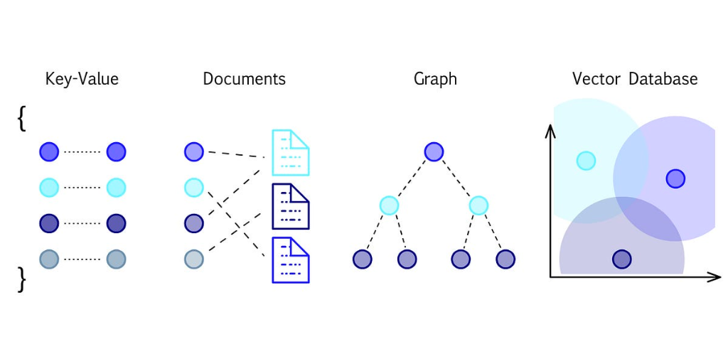
VectOr
Databases

Slide 37
Vector
Databases
Banana
Apple
Orange
Dog
Cat
Squirrel
Turtle
Eagle
T-Rex
Lizard
Crocodile
Chicken
Dove

Slide 38
What is
Retrieval
Augmented
Generation (RAG)?
Query Formulation: The process starts with the user input or query.
Information Retrieval: A retriever model searches a large dataset or knowledge base for relevant information.
Content Selection: The system filters and ranks the retrieved information to find the most relevant content.
Response Generation: A generator model creates a response using the selected content and the original query.
Refinement and Output: The generated response is refined for coherence and presented to the user.

Slide 39
RAG
Apps
Sources
Ingest
Vectorized Data
API
Client
Apps
Client
Apps
Sources
Embed
Client
Apps
Search
Sources
LLM Model
(Pretrained or Finetuned)
Vectorize
Vectorize
Generate
Generative Model
(Pretrained or Finetuned)
Generate

Slide 40
RAG
Apps
Resumes in PDF
Python Script
Milvus
Python API
Client
Apps
Client
Apps
Embed
HTML Client
Search
BERT for Embeddings
Vectorize
Vectorize
Generate
GPT 3.5 for Analysis
Generate

Slide 41
Multi-MOdal ApplicaitOns
API
Client
App
Context
LLM Model
(Pretrained)
Client
App
Context
Client
App
Context
AI Model
(Vision, Speech Recognition, etc.)

Slide 42
Multi-MOdal ApplicaitOns
Python API
Client
App
Context
GPT 3.5
Client
App
Context
HTML Client
Whisper for Speech to Text

